Slide 1

MAGNETISM
Notes:
Many of the diagrams in this presentation are from Pearson Physics 12 – an excellent resource.

Slide 2
MAGNETS
Like charged particles, when it comes to magnets – opposites attract.
Magnets are dipoles – any magnet that you pick up will have both a north and a south end. If you try to break the poles apart, you can’t; breaking a magnet just gets you a smaller magnet.
This means that, unlike charged particles where it is possible to isolate charges, it is not possible to isolate poles of a magnet. This is sometimes expressed as; “there’s no such thing as a magnetic monopole”.

Slide 3
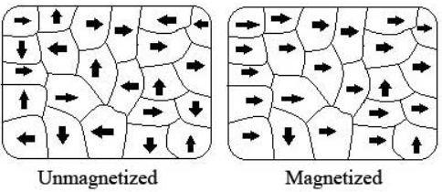
WHY ARE SOME MATERIALS MAGNETIC?
Particles of matter have various properties. Moving elementary particles (i.e. electrons), as well as some molecules, have something called a magnetic dipole moment, or simply magnetic moment.
Usually, a substance contains many of these magnetic moments, contained in regions called ‘domains’. These magnetic moments of these domains are usually aligned in a random orientation. As such, they exhibit no magnetic properties.

Slide 4
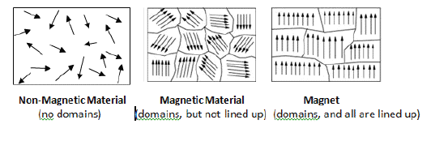
WHY ARE SOME MATERIALS MAGNETIC?
However, if all of the domains have their magnetic moments aligned in the same orientation, the substance will be magnetic.
A substance that does not normally have all of its’ domains aligned the same way, but is able to have them align in the presence of an external magnetic field, is not a magnet, but is able to be magnetised.

Slide 5
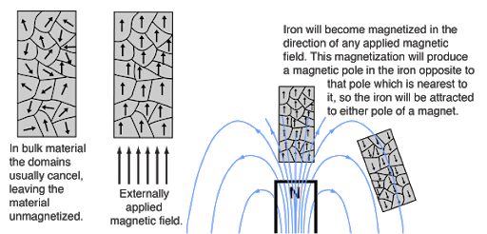

Slide 6
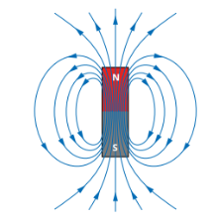
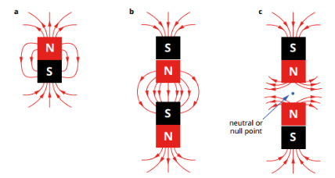
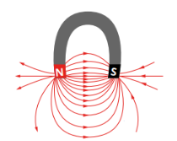
MAGNETIC FIELDS
Field lines go from North to South. Many of the other rules for field lines still apply (i.e. lines do not cross, etc.).

Slide 7
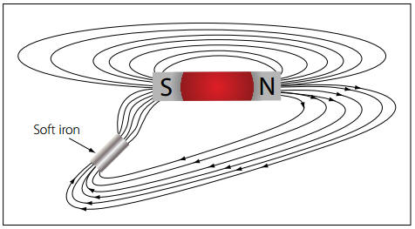
MAGNETIC FIELDS
Substances that can be magnetised can alter/concentrate field lines. ‘Soft iron’ is a good example of a substance with a high magnetic permeability.

Slide 8
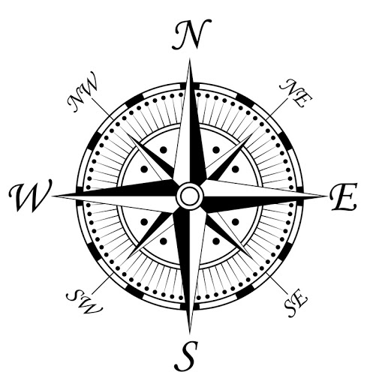
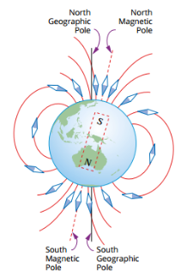
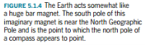
EARTH AS A MAGNET
The Earth has a magnetic field. Notice the positioning of the poles.
Current theories suggest that molten iron in the Earth’s Outer Core is responsible for the Earth’s Magnetic Field.
This also helps to explain why/how the poles seem to ‘wander’.
The ‘North’ Pole of a compass points here…

Slide 9
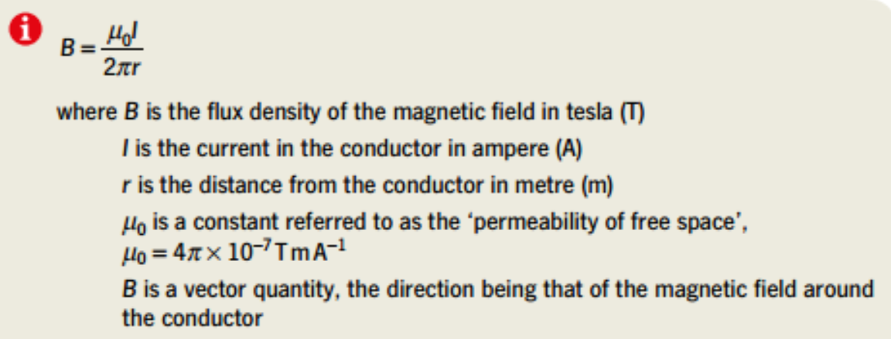
CURRENT-CARRYING WIRES
Current-carrying wires generate a magnetic field. This effect was discovered/explained by Dutch Physicist Hans Christian Oersted in 1820.
The magnitude of the field (i.e. the magnetic field strength) can be found using the following equation (Biot-Savart Law, which can be derived from Ampere’s Law for long, straight wires):
Just as different substances have different ‘permittivities’ for electric fields, they also have different ‘permeabilities’ for magnetic fields.
This is the permeability of free space (permeability of a vacuum). It is called the ‘Magnetic Constant’ on your data sheets.
Higher μ = more conductive of magnetic fields.

Slide 10
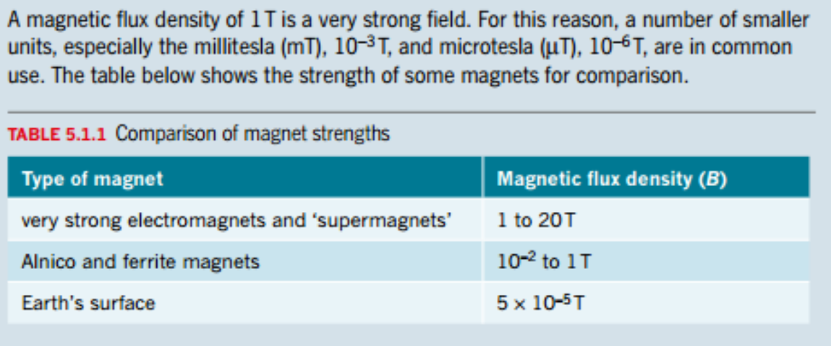
THE TESLA

Slide 11
FERROMAGNETISM
In Physics, several different types of magnetism are distinguished. Ferromagnetism is the strongest type.
Permanent magnets are either ferromagnetic or ferrimagnetic. Ferromagnetic materials have a magnetic permeability (μ) significantly greater than μ₀.
Only a few substances are ferromagnetic. The most common are Iron, Cobalt, Nickel and most of their alloys, and some compounds of rare earth metals.
Ferromagnetic materials can be divided into magnetically "soft" materials which can be magnetized but do not tend to stay magnetized (i.e. annealed iron), and magnetically "hard" materials, which do tend to stay magnetized. Permanent magnets are made from "hard" ferromagnetic materials such as alnico.

Slide 12
PARAMAGNETISM
Paramagnetism is a form of magnetism whereby some materials are weakly attracted by an externally applied magnetic field, and form internal, induced magnetic fields in the direction of the applied magnetic field.
Paramagnetic materials have a magnetic permeability (μ) slightly greater than μ₀.
Paramagnetism is due to the presence of unpaired electrons in the material. Most atoms with incompletely filled atomic orbitals are paramagnetic, although exceptions do exist, such as Copper. Paramagnetic materials include Aluminium, Oxygen, Titanium, and Iron (II) oxide (FeO).
Due to their spin (a quantum property), unpaired electrons have a magnetic dipole moment and act like tiny magnets. An external magnetic field causes a small fraction of the electrons' spins to align parallel to the field, causing a net attraction.
Unlike ferromagnets, paramagnets do not retain any magnetization in the absence of an externally applied magnetic field because thermal motion randomizes the spin orientations. Thus the total magnetization drops to zero when the applied field is removed.

Slide 13
DIAMAGNETISM
Diamagnetic materials are repelled by a magnetic field; an applied magnetic field creates an induced magnetic field in them in the opposite direction, causing a repulsive force.
The magnetic permeability of diamagnetic materials is less than the permeability of vacuum, μ₀. In most materials, diamagnetism is a weak effect which can be detected only by sensitive laboratory instruments, but a superconductor acts as a strong diamagnet because it repels a magnetic field entirely from its interior.
A simple rule of thumb is used in chemistry to determine whether a particle (atom, ion, or molecule) is paramagnetic or diamagnetic: If all electrons in the particle are paired, then the substance made of this particle is diamagnetic; If it has unpaired electrons, then the substance is paramagnetic.
Diamagnetic materials are those that some people generally think of as non-magnetic, and include water, wood, petroleum, some plastics, and many metals including Copper, Mercury, Gold and Bismuth.

Slide 14
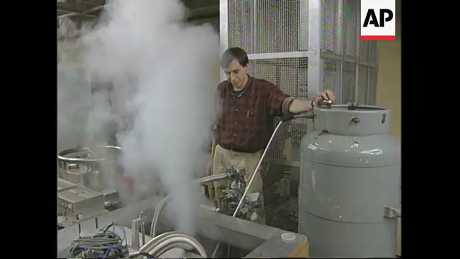

Slide 15
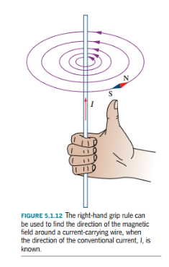
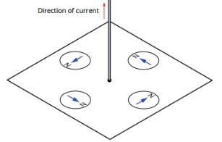
CURRENT-CARRYING WIRES
The direction of the field can be found using the ‘Right-Hand Screw Rule’ (a.k.a. the ‘Right-Hand Grip Rule’).
Note: The field lines (i.e. the concentric circles around the wire) are not evenly spaced apart; they get further apart as the we get further from the wire. This is no accident – according to Ampere’s Law, the field gets weaker further from the wire, hence the field lines are further apart.
Notes:
Drop your Pen to do this!!!

Slide 16
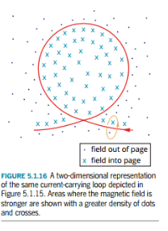
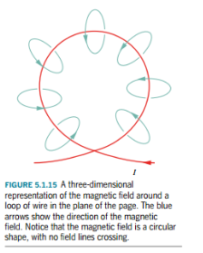
CURRENT-CARRYING WIRES
We can use our ‘Grip Rule’ for 3D fields too…
Dots = Out of Page.
X = Into Page.
Notes:
Drop your Pen to do this!!!

Slide 17
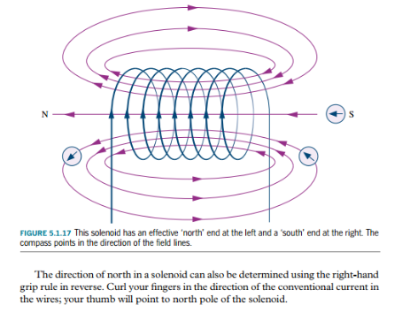
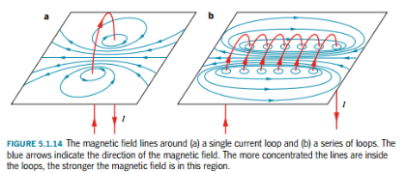
CURRENT-CARRYING WIRES
A coil of wire is called a ‘solenoid’. We can use our Grip-Rule here too.
Notes:
Drop your Pen to do this!!!

Slide 18
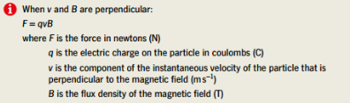
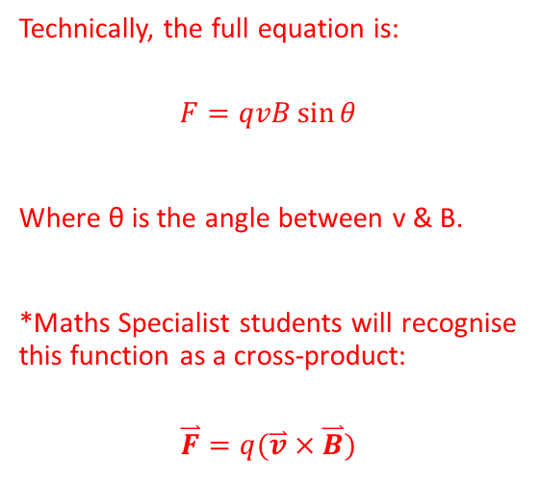
FORCES ON CHARGED PARTICLES
Charged particles moving through magnetic fields, such that their velocity vector is not parallel to the magnetic field, will experience a force. This force is known as the Lorentz Force.
Technically, the full equation is:
$$F=qvB\sin{θ}$$
Where θ is the angle between v & B.
*Maths Specialist students will recognise this function as a cross-product:
$$\overset{⃑}{F}=q(\overset{⃑}{v}×\overset{⃑}{B})$$

Slide 19
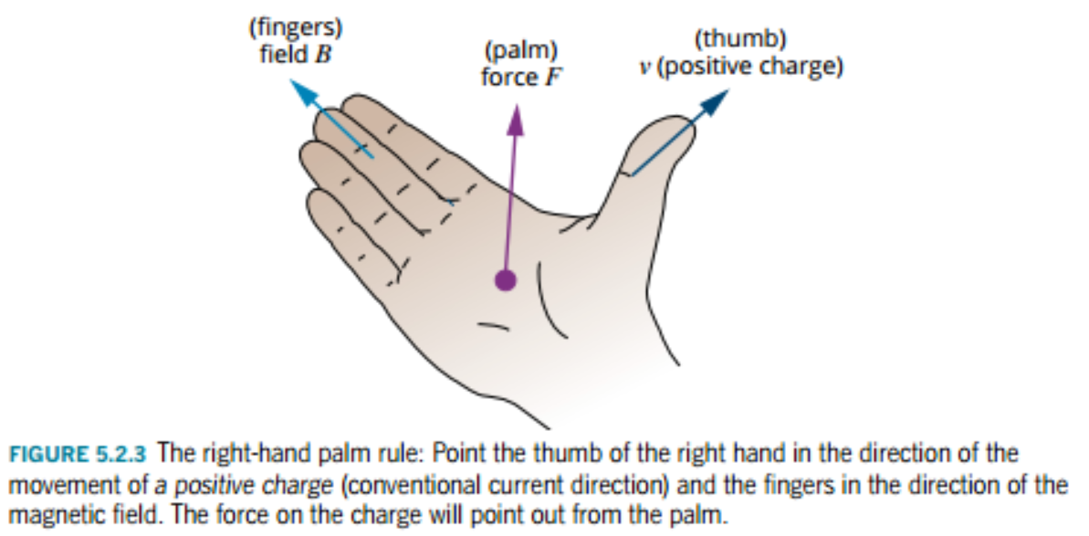
FORCES ON CHARGED PARTICLES
To find the direction of the force acting on the charged particle, we use something called the right-hand palm rule (or the right-hand slap rule):
Note: If the charge is negative, then the force comes out of the back of the hand…
Notes:
The cross product of two vectors a and b is defined only in three-dimensional space and is denoted by a × b. In physics and applied mathematics, the wedge notation a ∧ b is often used (in conjunction with the name vector product), although in pure mathematics such notation is usually reserved for just the exterior product, an abstraction of the vector product to n dimensions.
The cross product a × b is defined as a vector c that is perpendicular (orthogonal) to both a and b, with a direction given by the right-hand rule and a magnitude equal to the area of the parallelogram that the vectors span. ^{(Wikipedia)}

Slide 20
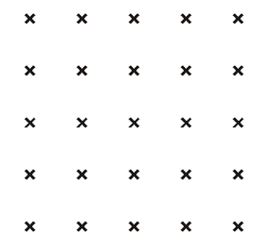
B
B
v
+
v
+
v
-
Force = out of page
Find the direction of the resultant force and describe the motion of each particle…
Particles undergo… circular motion!

Slide 21
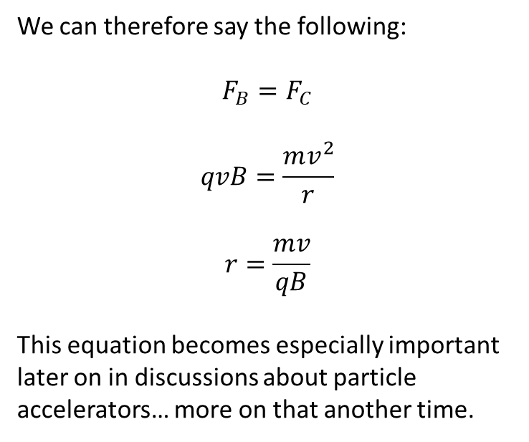
B
We can therefore say the following:
$$F_{B}=F_{C}$$
$$qvB=\frac{mv^{2}}{r}$$
$$r=\frac{mv}{qB}$$
This equation becomes especially important later on in discussions about particle accelerators… more on that another time.
v
+
v
-
Particles undergo… circular motion!

Slide 22
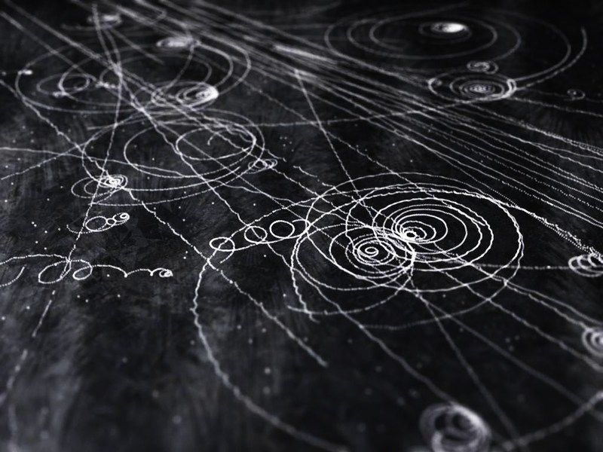
DISCOVERING NEW PARTICLES WITH ELECTROMAGNETISM

Slide 23
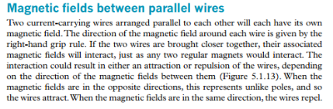
FORCE BETWEEN CURRENT-CARRYING WIRES
Notes:
Drop your Pen to do this!!!

Slide 24

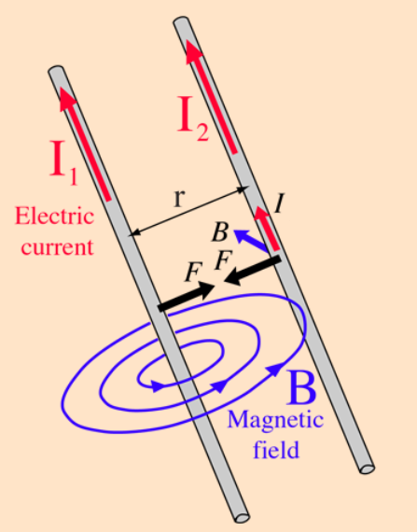
FORCE BETWEEN CURRENT-CARRYING WIRES
Using Ampere’s Law & our Right-Hand Grip Rule, we can work out the direction of the magnetic field from wire 1 at the location of wire 2.
Then, using the Lorentz Law & the Right-Hand Slap Rule (thumb in direction of motion of ‘+’ve charged particles i.e. direction of conventional current, fingers in direction of B), we can work out the force experienced by wire 2 due to wire 1. This is a symmetrical argument.
We can use similar logic to predict the outcome of currents flowing in opposite directions.

Slide 25

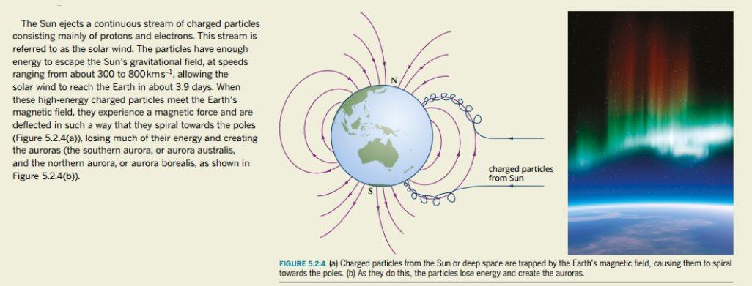
THE AURORA

Slide 26

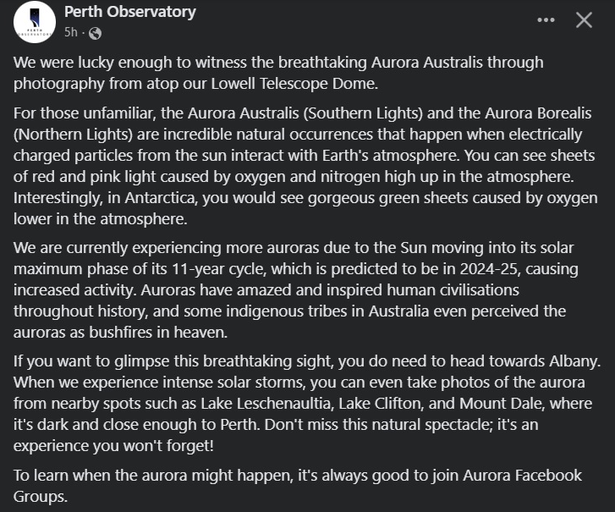

Slide 27

Notes:
Injidup Beach End of Feb 2023 – near Dunsborough

Slide 28
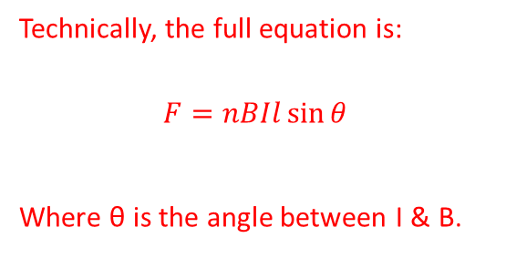
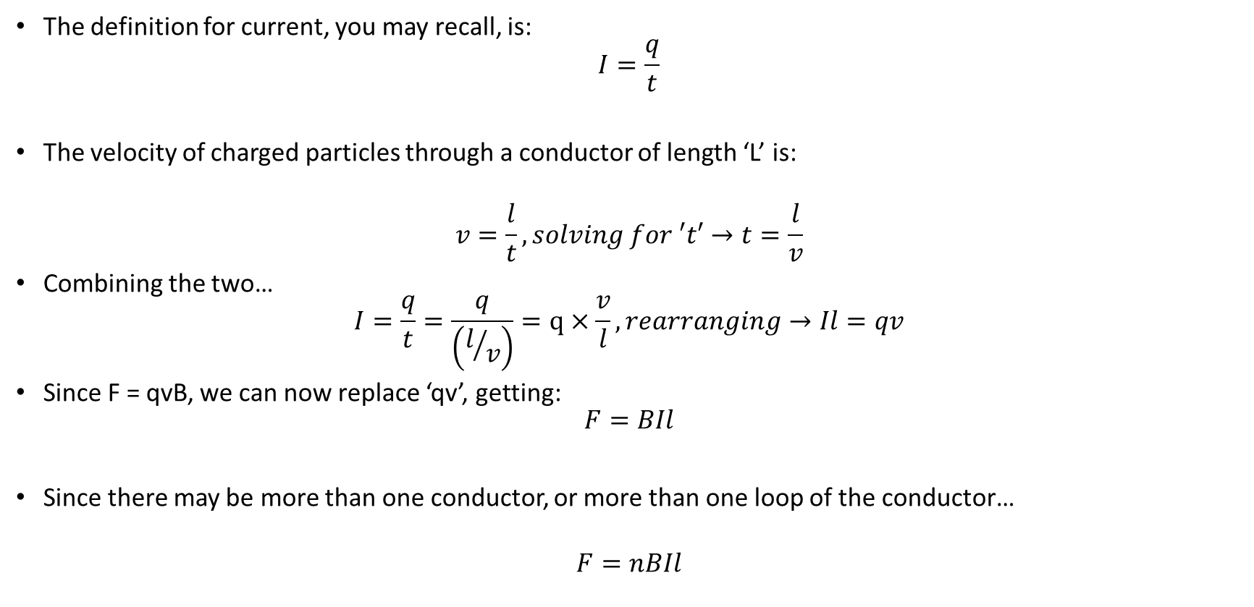
FORCE ON A CONDUCTOR
The definition for current, you may recall, is:
$$I=\frac{q}{t}$$
The velocity of charged particles through a conductor of length ‘L’ is:
$$v=\frac{l}{t}, solving for ′t′→t=\frac{l}{v}$$
Combining the two…
$$I=\frac{q}{t}=\frac{q}{\left(l/v\right)}=q×\frac{v}{l}, rearranging→Il=qv$$
Since F = qvB, we can now replace ‘qv’, getting:
$$F=BIl$$
Since there may be more than one conductor, or more than one loop of the conductor…
$$F=nBIl$$
Technically, the full equation is:
$$F=nBIl\sin{θ}$$
Where θ is the angle between I & B.

Slide 29
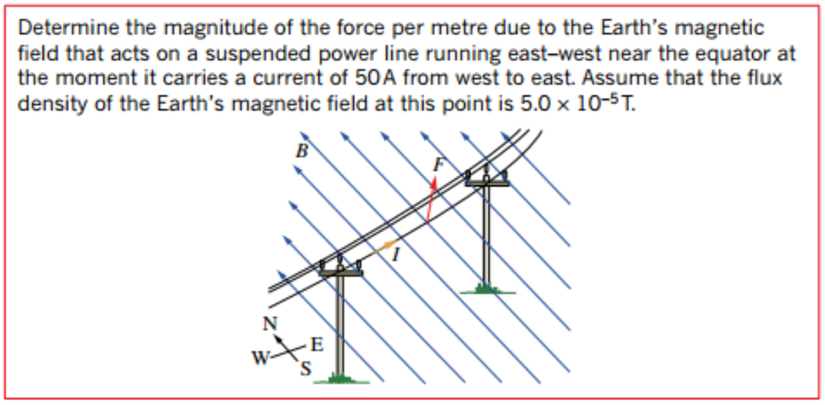

Slide 30
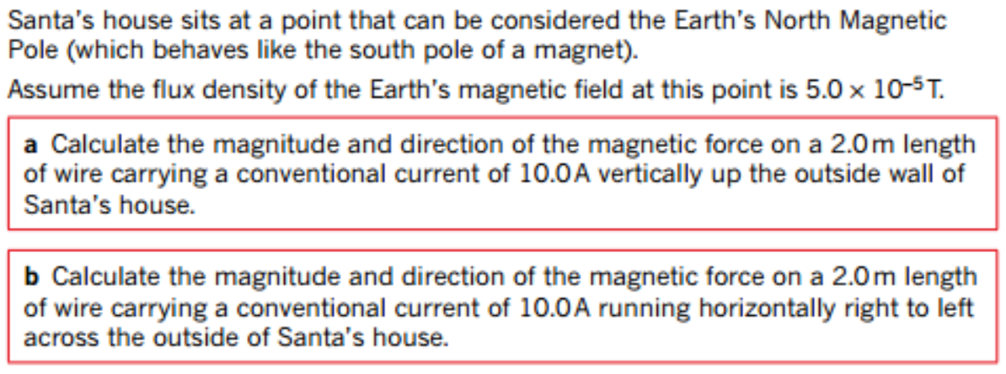

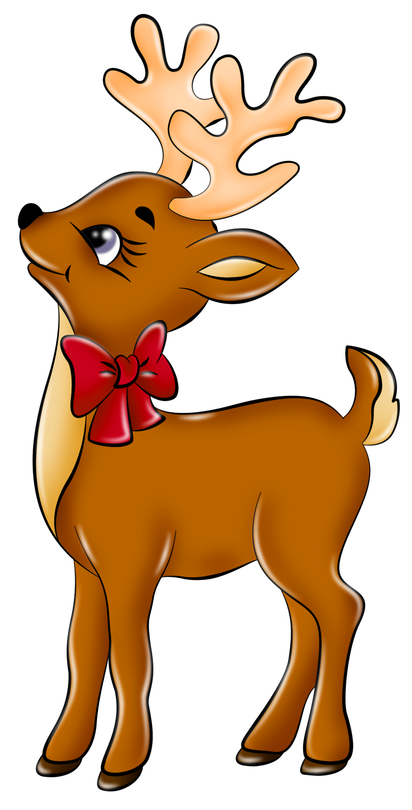


Slide 31
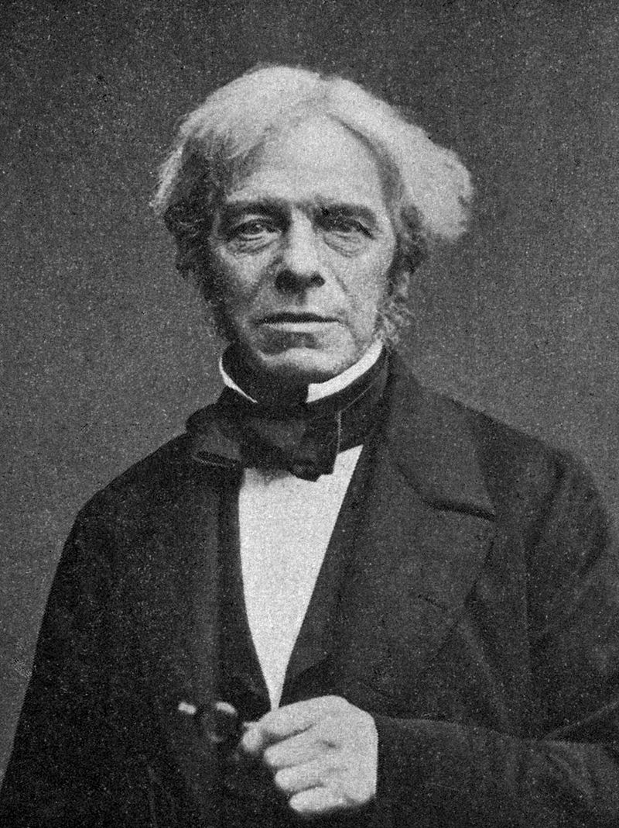
DC MOTORS
The prototype electric motor was invented by Michael Faraday in 1821. A motor is a device for transforming electrical energy into kinetic energy.
The set-up is quite simple: run a current through a conducting wire loop, and place the loop in a magnetic field. This generates a force on the sections of the loop that run perpendicular to the magnetic field, generating a torque.

Slide 32
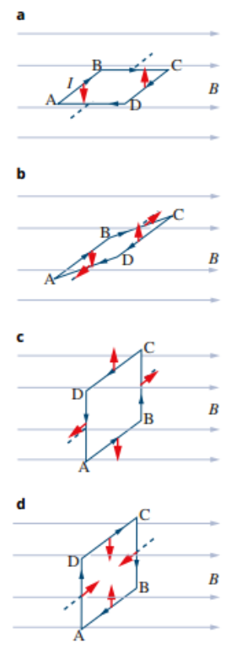
DC MOTORS
For a single conducting loop, the coil will only turn 90˚ (from horizontal to vertical) before the torque turns to 0.
The coil will usually continue spinning due to its’ own momentum, however the forces will push the loop back into a vertical position. This is not ideal as we want the coil to keep spinning.
To solve the problem, we need to change the direction of the current every half-turn; once the coil reaches the vertical position (c), changing the direction of the current changes the direction of the force on the wire. Hence, the torque will continue acting in the same direction and the coil will keep spinning.

Slide 33
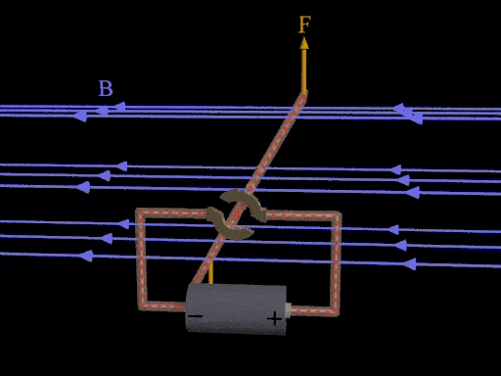
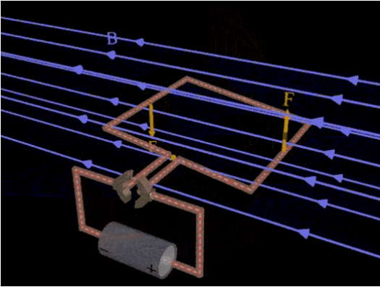
F = F, r = r(max), F┴r, ∴ τ = rF
*C = axis of rotation.
C
F
R

Slide 34
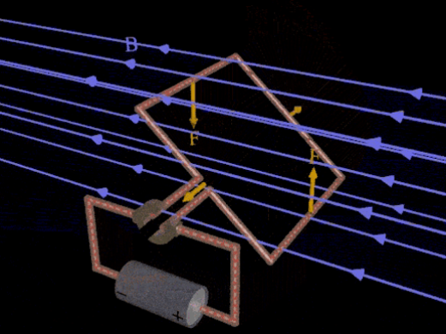
F = F, r < r(max), F┴r, ∴ τ = rF (but as ‘r’ is smaller, τ is also smaller).
C
F
R

Slide 35
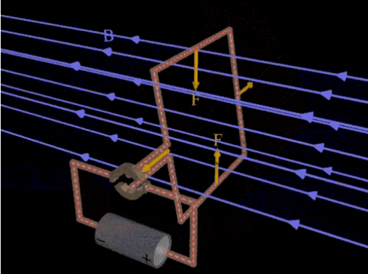
F = F, r << r(max), F┴r, ∴ τ = rF (but as ‘r’ is even smaller, τ is also much smaller).
What happens when the coil reaches vertical orientation?
C
F
R
Notes:
R = 0, τ = 0. Momentum carries the loop past vertical point, but for torque to continue in the same direction the current must change direction at this point.

Slide 36
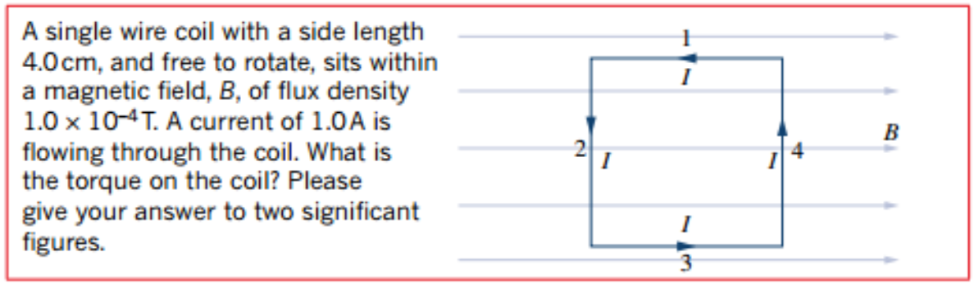
Notes:
Remember: find the torque from one side of the coil, then double it to find total torque (as both left and right sides of the coil contribute to torque).

Slide 37
PARTS OF A DC MOTOR
Coil – the conductor through which the current travels.
Core – the coil is usually wrapped around a soft-iron core to increase magnetic field intensity.
Armature/Rotor – the core/coil combination is often referred to as the armature (or the rotor, because it rotates through the field).
Stator – provides the magnetic field (either a permanent magnet or an electromagnet). It remains stationary, hence ‘stator’.
Commutator – changes the direction of the current through the coil every half-turn. Most common form in a DC motor is the ‘split-ring commutator’.
Brushes – connects the commutator to the external circuit without loss of electrical contact when rotating. Usually heat/friction resistant, must be conductive (Carbon often used).

Slide 38
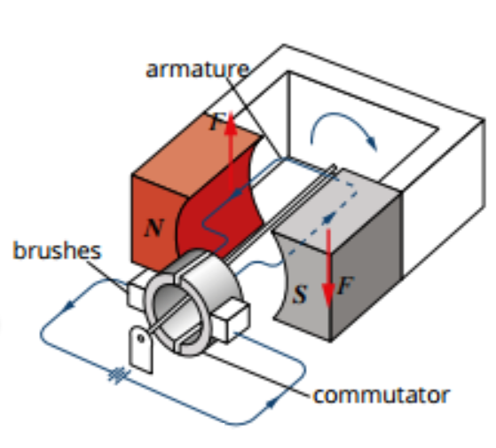
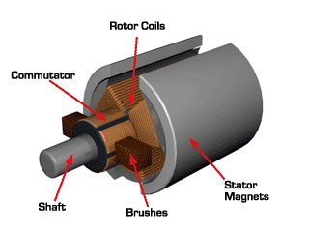
PARTS OF A DC MOTOR

Slide 39
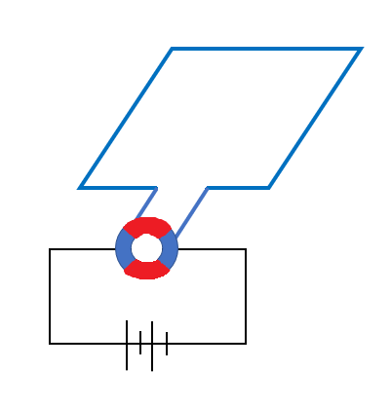
DC MOTOR
B
Torque (on each side):
τ = rF
∴ Total torque:
τ = 2rF
This is the MAXIMUM Torque experienced by the motor: τ_{MAX}
This coil is rotating counter-clockwise.
F
F
I

Slide 40
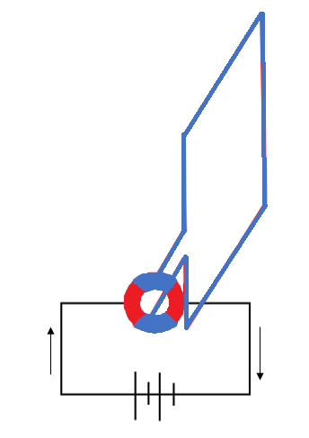
DC MOTOR
Torque (on each side):
τ = rF, however r = 0
∴ Total torque:
τ = 0
This is the MINIMUM Torque experienced by the motor: τ_{MIN}
This coil will only continue rotating if the current changes direction (due to the commutator).
*As the torque is always in the same direction, it will never be negative.
B
F
F
I

Slide 41
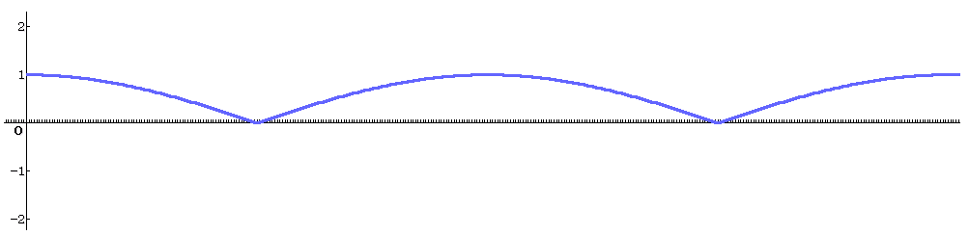
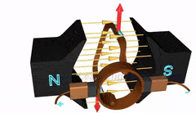
TORQUE ON A DC MOTOR
τ
θ
*This creates a “stop-start” or “jerky” type of motion; the torque varies from maximum to zero. It would be better if we had a smoother type of motion, with a more consistent torque (or at least, a torque that does not go to zero). How could we achieve this?

Slide 42
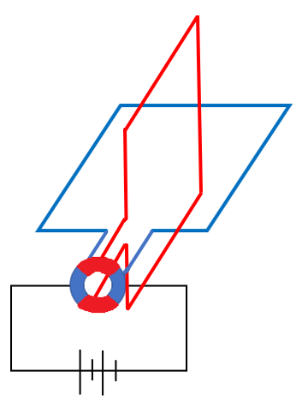
DC MOTOR
B
F
F
I
*Answer: By adding a second coil at right angles to the first! Now what will our torque look like?

Slide 43
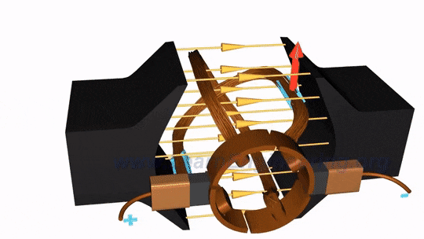
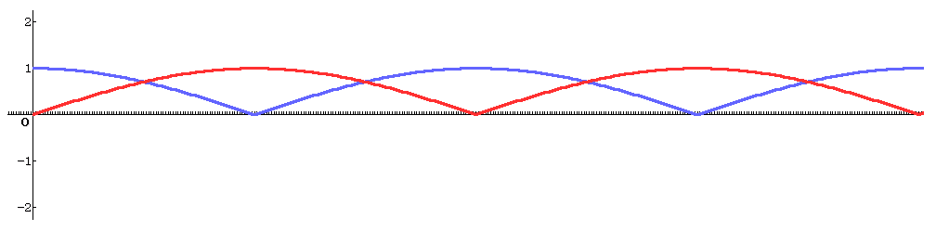
TORQUE ON A DC MOTOR
τ
θ
*Now, as one coil approaches zero torque, the other approaches maximum torque. The total torque will never reach zero, resulting in a much smoother rotation.

Slide 44

TORQUE ON A DC MOTOR
τ
θ
*Of course, we could get the motion to be even smoother, by adding even more coils. Doing this would, eventually, cause the plot of torque vs. angle of rotation to approach a straight horizontal line.

Slide 45


TORQUE ON A DC MOTOR
τ = 2rFsinθ
F = nBIL
∴ τ = 2rnBIL sinθ
*From diagram: r = w/2
∴ τ = wnBIL sinθ
*Area (A) = L x w
∴ τ = nBIA sinθ
Notes:
Since r & A don’t move with respect to each other, we can redefine θ from ‘the angle used to find the component of r that is perpendicular to F’ in our torque expression, to ‘the angle between the area vector and B field’, which turns out to be functionally the same.

Slide 46

TORQUE ON A DC MOTOR - QUESTION
Notes:
Ans: 0.069 Nm

